Slide 1


SMART WHEELCHAIR
MOVE FREELY !

Slide 2
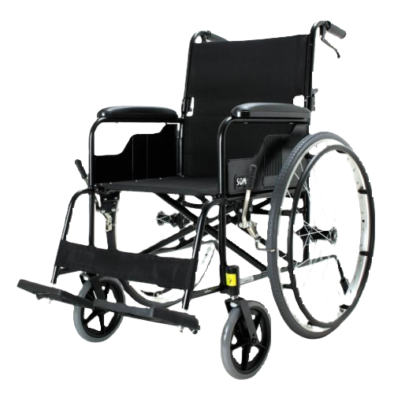
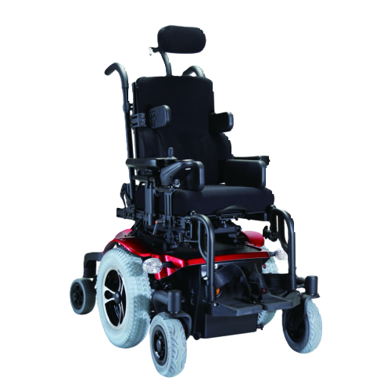
Motivation
Require physical strength.
Caregiver being around all the time.
Not suitable for all types of disability.
Only support Joystick
Can’t provide any medical assistance.
Require to Muscular effort.
Not flexible
MOVE FREELY !

Slide 3



Target Market
Individuals with impaired mobility:
Hospitals
Public places
Retirement home
Homes
Paraplegia
Quadriplegia (with neck control).
Quadriplegia (with no neck control).
MOVE FREELY !

Slide 4




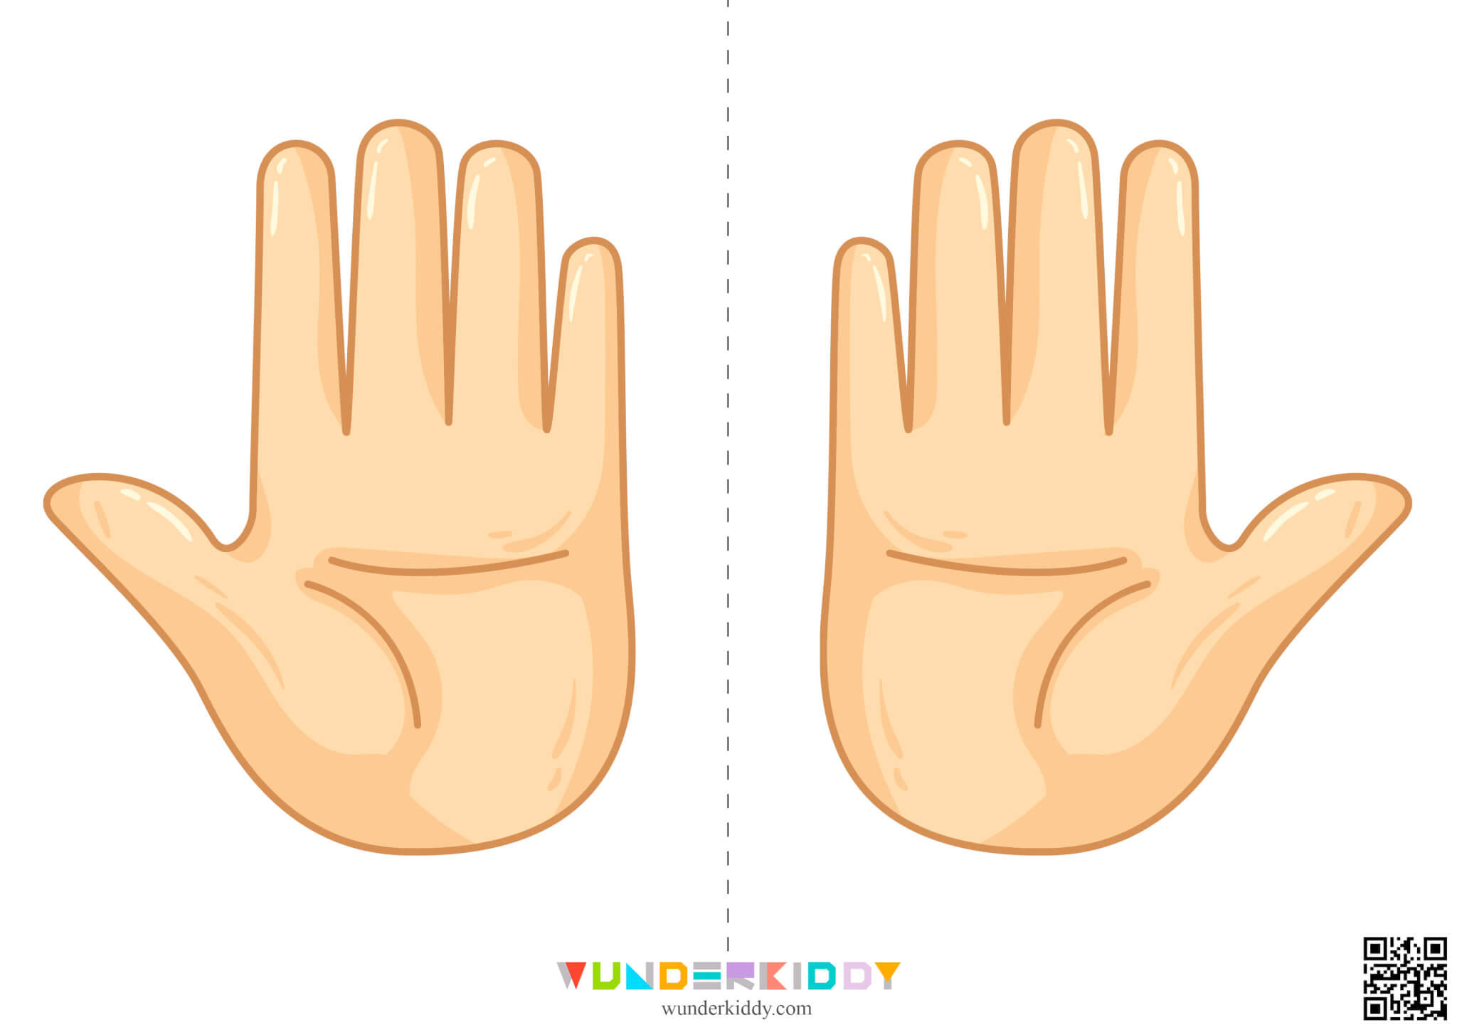
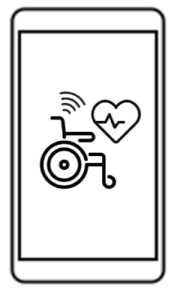
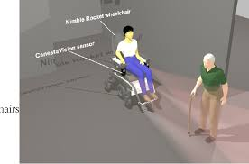

Our Solution
MOVE FREELY !

Slide 5

Mobile Application
MOVE FREELY !

Slide 6

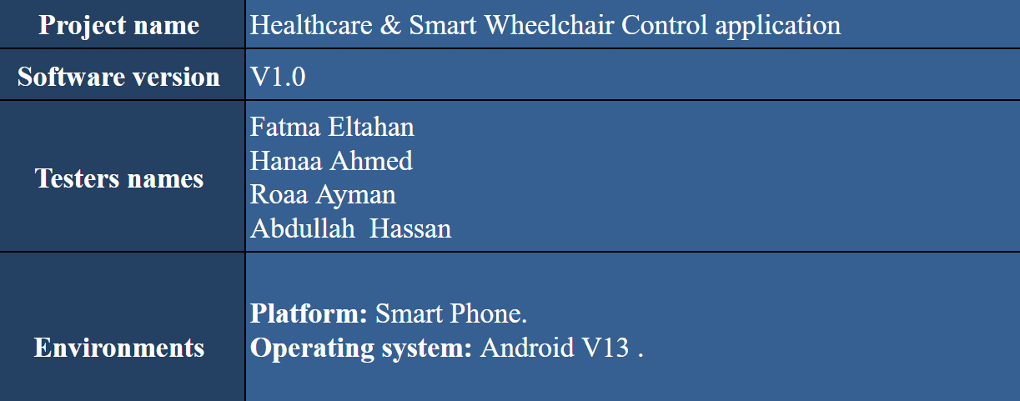
Tested by Testination – ITI Software Testing Team
MOVE FREELY !

Slide 7
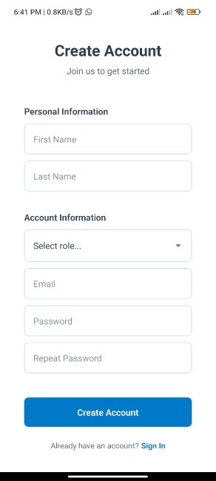
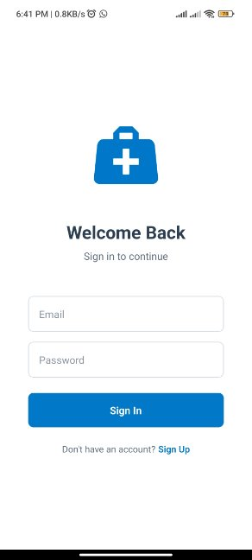
Authentication as patient or caregiver
MOVE FREELY !

Slide 8
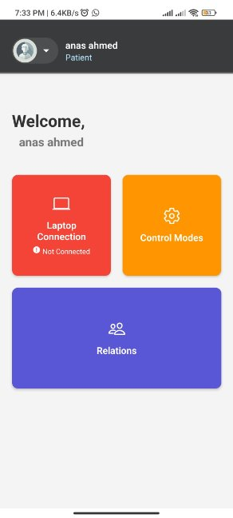
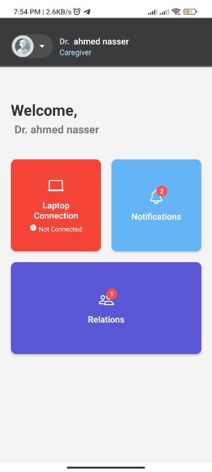
Home Screen
Patient Home
Caregiver Home
MOVE FREELY !

Slide 9
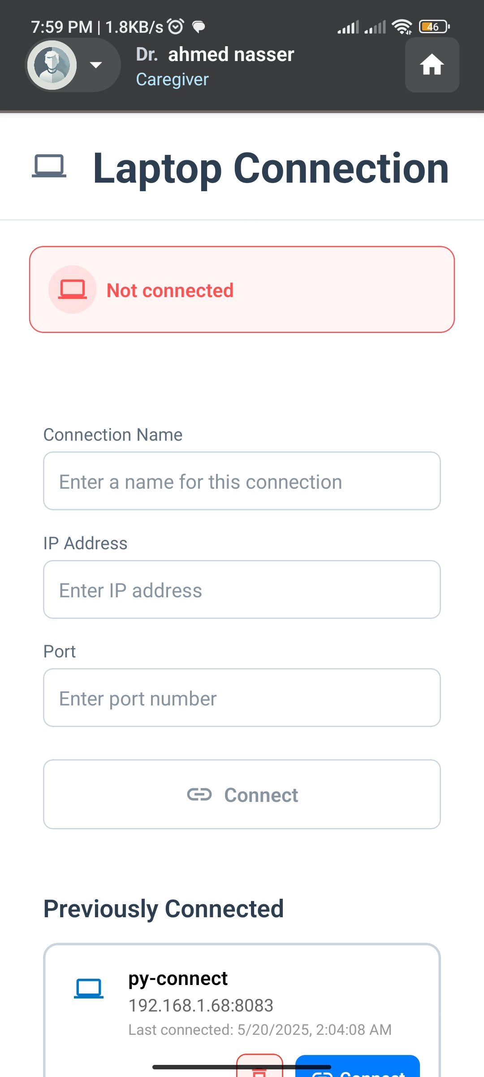
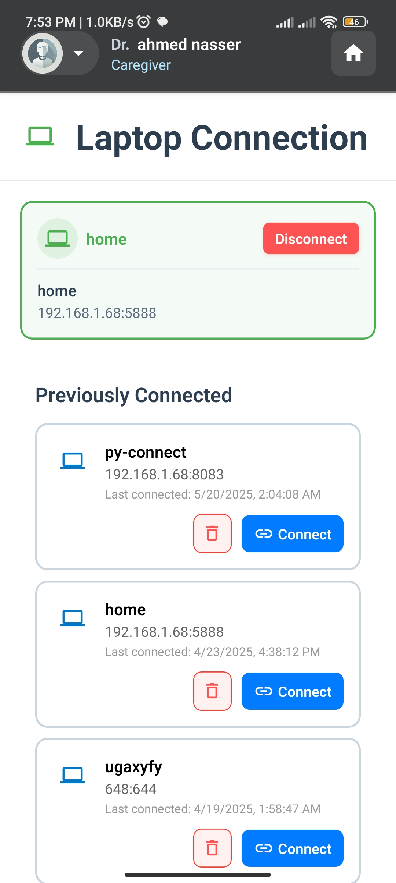
Laptop Connection screen
MOVE FREELY !

Slide 10
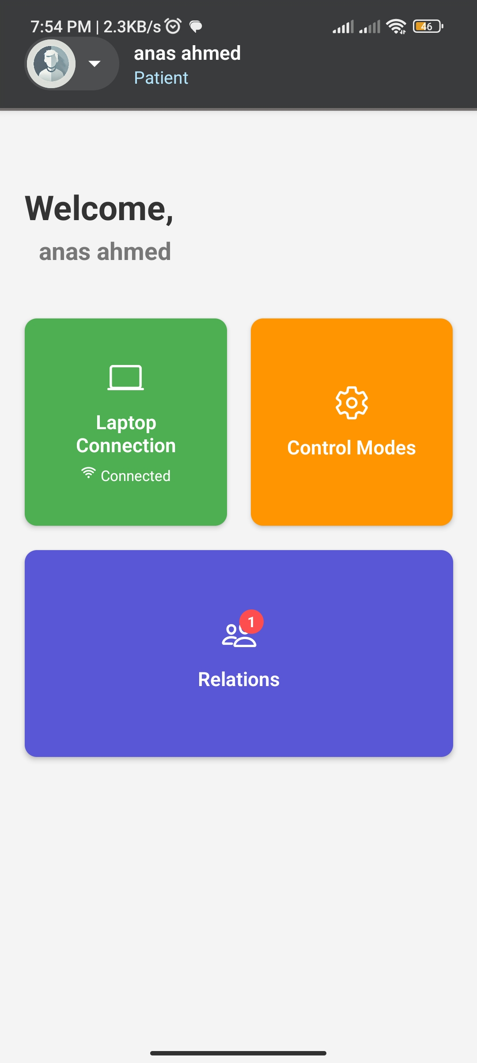
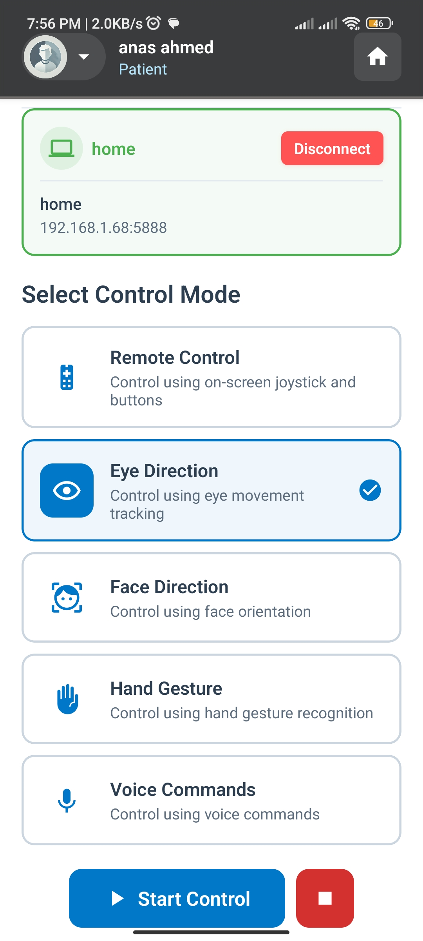
Mode Selection screen
MOVE FREELY !

Slide 11
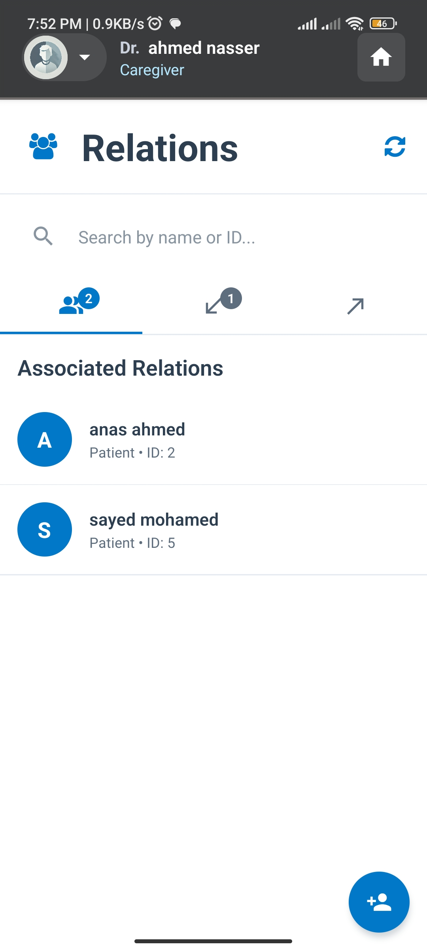
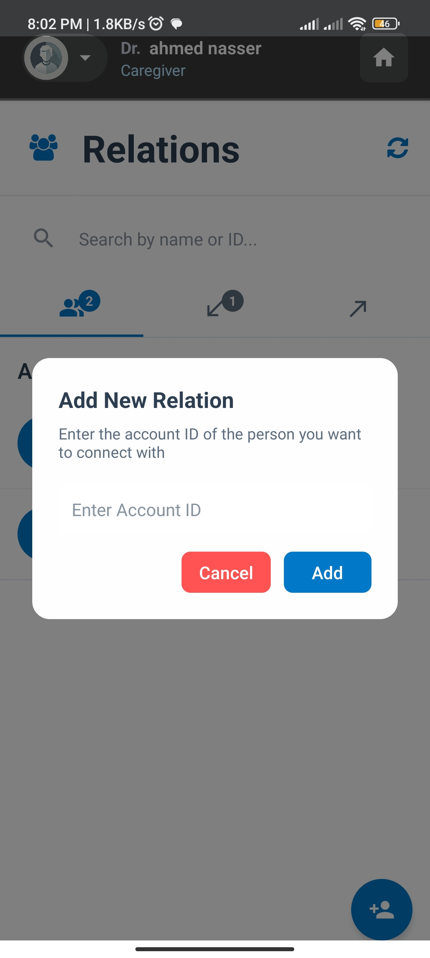
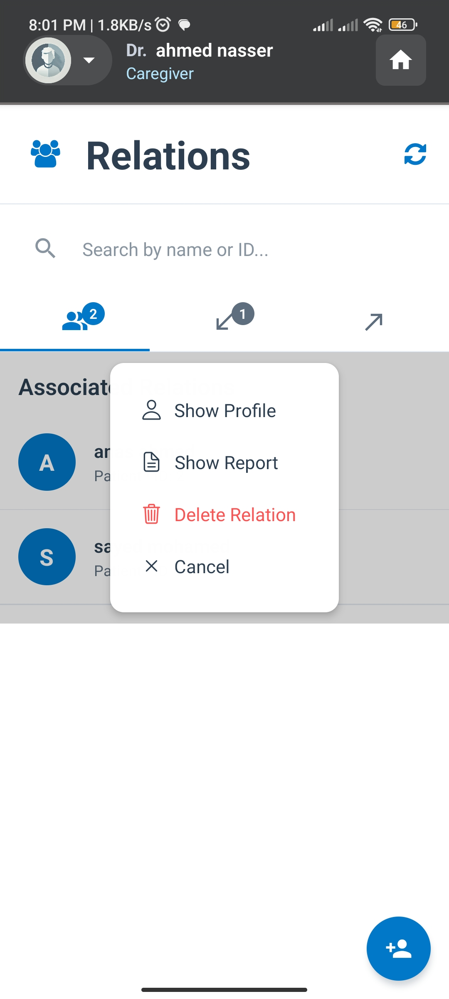
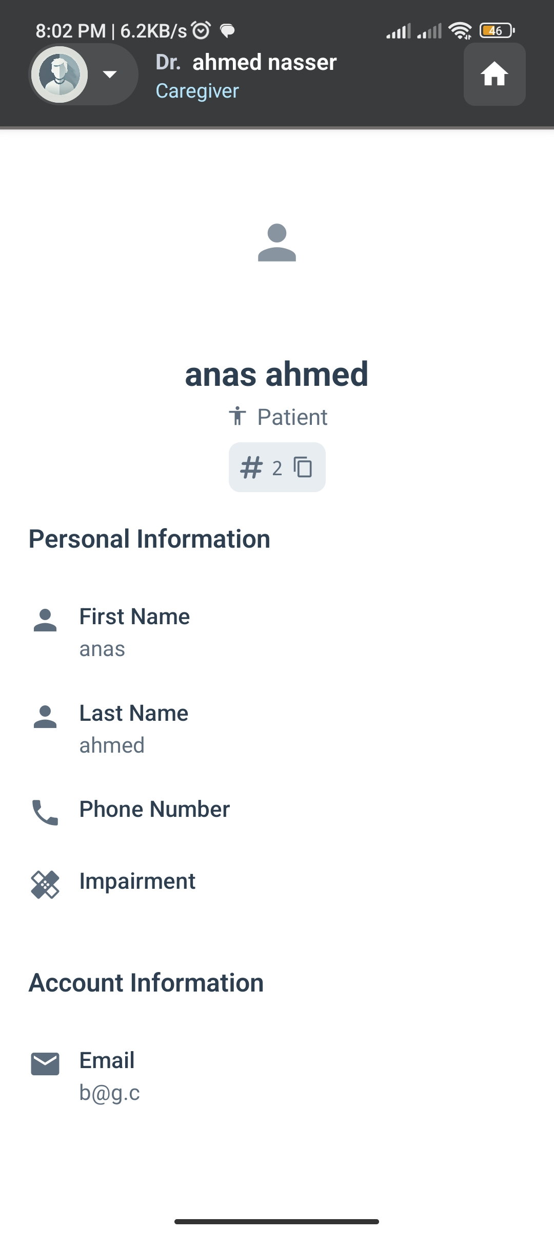
Relations screen
MOVE FREELY !

Slide 12
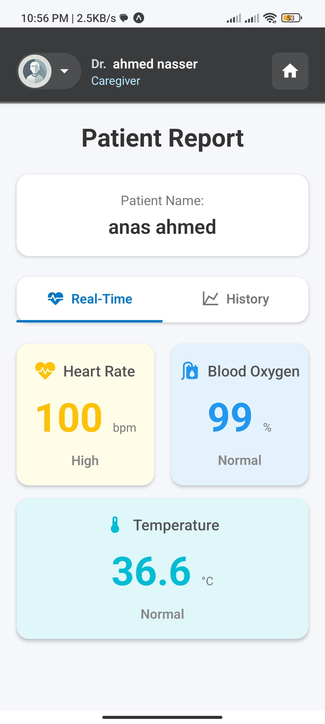
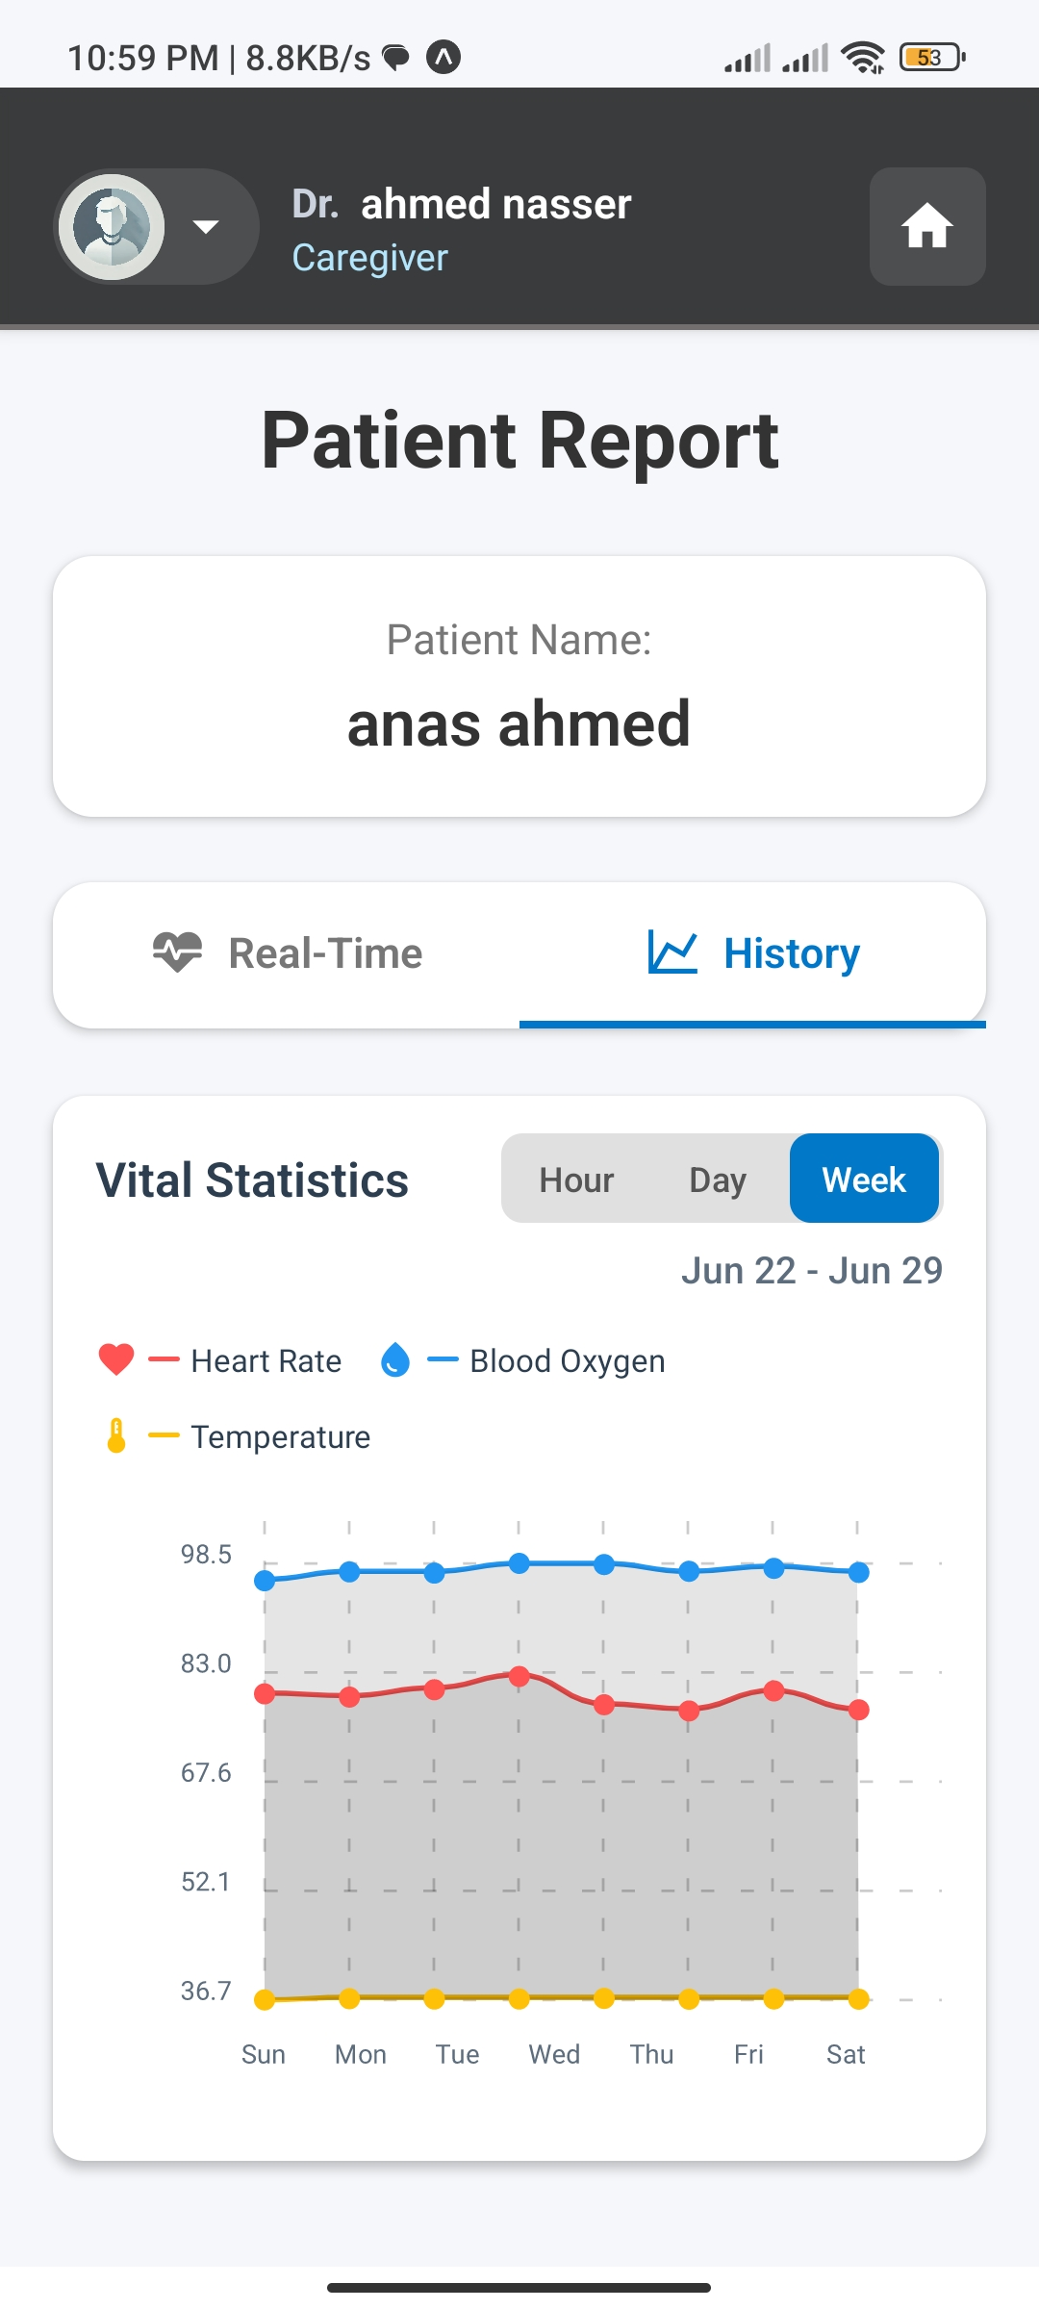
Patient Vital information
MOVE FREELY !

Slide 13

Control Modes
MOVE FREELY !

Slide 14
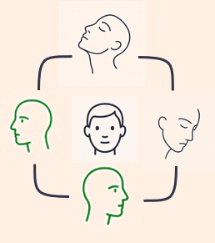





A
Face Movement Mode
MOVE FREELY !

Slide 15
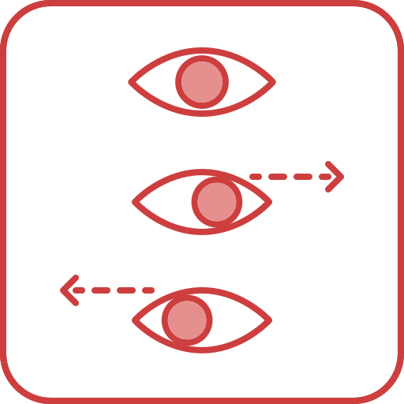
B
Eye Movement Mode (Eye Gaze )
MOVE FREELY !

Slide 16

C
Voice Movement Mode
MOVE
LEFT
RIGHT
STOP
MOVE FREELY !

Slide 17

D
Gesture Hand Mode
FORWARD
LEFT
RIGHT
STOP
MOVE FREELY !

Slide 18
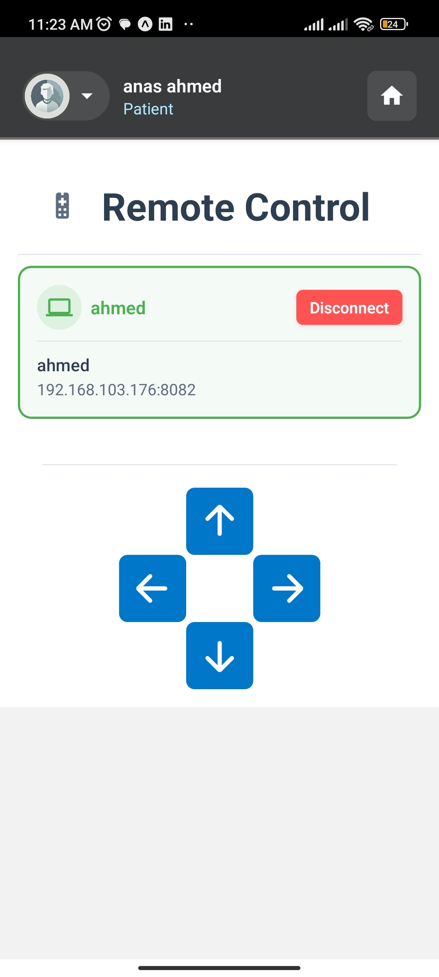
E
Remote Control Mode
MOVE FREELY !

Slide 19
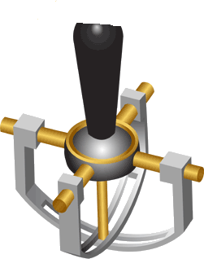
F
Manual Mode (Joystick)
MOVE FREELY !

Slide 20
Healthcare System
MOVE FREELY !

Slide 21
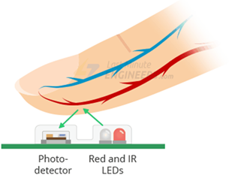
1
Pulse Oximeter and Heart Rate Sensor
2
Temperature Sensor
MOVE FREELY !

Slide 22
Any Questions ?!
Thank you
MOVE FREELY !

